Slide 1
INDIAN ECONOMY 1950-1990
Chapter II

Slide 2
INTRODUCTION
This is the history of Indian Economy immediately after independence till reforms which began in 1991.
After independence , the job of nation building was in our own hands.
The leaders had to decide , among other things, the type of economic system most suitable for our nation.
Out of capitalism , socialism and mixed economy , India envisaged an economic system which combines the best features of capitalism and socialism – the mixed economy.
India would be a socialist society with a strong public sector.
The Industrial Policy Resolution of 1948 and the Directive Principles of the Indian Constitution assigned a leading role to the public sector.
The private sector would be encouraged to take active part in the developmental plans of the government.
In 1950, the Planning Commission was set up with the Prime Minister as its Chairperson.
The Planning Commission fixed the planning period at five years, which began the era of ‘Five Year Plans’

Slide 3
PLAN
Plan: A plan spells out how the resources of a nation should be put to use. It should have goals – general goals as well as specific goals to be achieved within a specified period of time. In India, plans are of five year duration and are called Five Year Plans, which we borrowed from the former USSR, ( Union of Soviet Socialist Republic) the pioneer in national planning.
Perspective Plan, which specifies the objectives to be achieved over a period of twenty years.
Long term objectives – removal of unemployment and poverty , reduction of inequalities. To bring structural changes in the economy.
Medium term objectives – bring more of quantitative changes ( increase in agricultural productivity, industrial production etc) Intended to solve the immediate and urgent economic problems of the country as and when they crop up.

Slide 4
BASIC GOALS OF FIVE-YEAR PLANS
Growth
Modernization
Self-Reliance
Equity

Slide 5
BASIC GOALS OF FIVE-YEAR PLANS
GROWTH
Increase in the country’s capacity to produce the amount of goods and services within the country.
Either a large stock of productive capital
Or a large size of supporting services like transport and banking
Or an increase in the efficiency of productive capital and services
A good indicator of economic growth is steady increase in the GDP.

Slide 6
BASIC GOALS OF FIVE-YEAR PLANS
MODERNISATION
Adoption of new technology-To increase the production of goods and through the use of new technology.
Change of social outlook – To aim at gender empowerment – to provide equal rights to women.

Slide 7
BASIC GOALS OF FIVE-YEAR PLANS
SELF-RELIANCE
To stand on one’s own foot – to have development through domestic resources.
To promote economic growth and modernisation so that dependence on foreign countries would be reduced.
Self-Reliance is necessary to reduce foreign dependence and most importantly to avoid foreign interference.

Slide 8
BASIC GOALS OF FIVE-YEAR PLANS
EQUITY
In a welfare state it is important to ensure that benefits of economic prosperity are availed by all sections of the economy.
Thus in addition to growth, modernisation and self-reliance, equity is also important.
Thus every individual in a country should be able to meet the basic needs of life and inequality in distribution of wealth should be reduced.
Thus equity aims to raise the standard of living of all people and promote social justice.

Slide 9
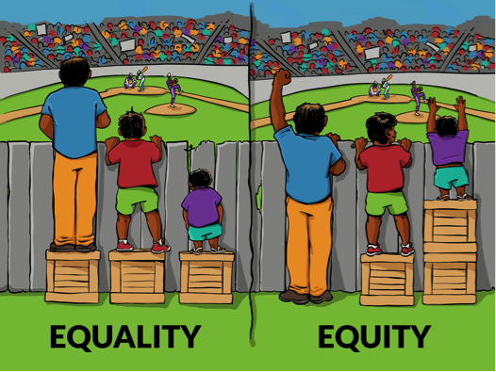
vs

Slide 10
Post Independence Reforms

Slide 11
TO STUDY UNDER THE FOLLOWING HEADS
Agriculture
Land Reforms
Land Ceiling
The Green Revolution
Industry and Trade
Public and Private sectors in Indian Industrial Development
Industrial Policy Resolution 1956 (IPR 1956)
Small Scale Industry
Trade Policy
Effect of polices on Industrial Development

Slide 12
1. AGRICULTURE
FEATURES OF INDIAN AGRICULTURE DURING INDEPENDENCE
Low Productivity
Disguised unemployment
High dependency on rainfall
Subsistence farming
Outdated technology
Conflicts between tenants and landlords

Slide 13
1. AGRICULTURE
MEASURES TAKEN TO MITIGATE THE ABOVE PROBLEMS
Land Reforms
It primarily refers to change in the ownership of landholdings.
Abolition of intermediaries (zamindars, jagirdars) was an important feature of land reforms.
Ownership of land was given to the actual tillers.
200 lakh tenants were brought into direct contact with the government.
Sufficient capital was made available to them.
It became an incentive to increase output.

Slide 14
1. AGRICULTURE
MEASURES TAKEN TO MITIGATE THE ABOVE PROBLEMS
Land ceiling
It refers to fixing the specified limit of land, which could be owned by an individual.
Beyond this limit, the excess land would be taken over by the government .
The above-mentioned excess lands will be allocated to the landless cultivators and small farmers.
But the act was challenged by the big landlords. They delayed its implementation.
This delay time was used by them to register the excess lands in the names of their close relatives, thereby escaping from the legislation.
Land reforms were successful in the states of Kerala and west Bengal.
Governments of these states were committed to the policy of land reforms.
Unfortunately, other states did not implement the policy sincerely and inequality in landholdings continued.

Slide 15
1. AGRICULTURE
MEASURES TAKEN TO MITIGATE THE ABOVE PROBLEMS
Green revolution
It refers to the large increase in the production of food grains resulting from the use of High Yielding Variety (HYV)seeds .
These seeds were used in the places with adequate facilities of drainage and water supply.
These seeds need heavy doses of chemical fertilisers to get largest possible production.
In the first phase the use of HYV seeds were restricted to the states of Punjab, Andhra Pradesh, Tamil Nadu etc.
In the second phase the technology was spread to large number of states.
More variety of crops were grown on large quantity.
Effects of Green Revolution:
Attaining Marketable Surplus: It refers to that part of agricultural produce which is sold in the market by the farmers after meeting their own consumption requirement.
A good proportion of rice and wheat grown during green revolution was sold by the farmers in the market.
Buffer stock of food grains: The government could procure sufficient amount of food grains to build a stock which could be used during times of scarcity.
Benefit to low income groups: Due to large supply of food grains, the price of the grains declined. The low-income group people who spent a large portion of their income on food, benefitted from this decline in prices.

Slide 16
1. AGRICULTURE
MEASURES TAKEN TO MITIGATE THE ABOVE PROBLEMS
Risks involved under Green Revolution:
Risk of pest attack: The HYV crops were more prone to attack by pests. Thus small farmers who adopted this technology could lose everything in a pest attack. But the risk was reduced by the services rendered by the research institutes established by the government.
Risk of increase in income inequality: Mostly the big farmers could adopt the technology. Thus their income would increase considerably which may result in income disparity between small and big farmers.
Even this risk was overcome because of the steps taken by the government.
Government provided loans at a low rate of interest to small farmers.
Fertilisers were provided at subsidised rates.
Thus, even the small farmers could obtain the inputs for their crops.
So the output on small farms equalled the output on large farms in the course of time.
Thus the green revolution benefitted both the rich and the small farmers.
But in the case of certain states where the respective governments did not play an extensive role in implementing green revolution, the technology favoured only the rich farmers.

Slide 17
OBJECTIVES OF FIVE YEAR PLANS
Plan (1951-56) : Raise agricultural production
Plan ( 1956 – 61) : Rapid Industrialisation
Plan ( 1961 – 66 ) : Self – Sufficiency in foodgrains and expand basic industries
Plan (1969-74) : Self – Reliance
Plan ( 1974 – 79) Self – Reliance and removal of poverty
Plan ( 1980 – 85) Self – Reliance
Plan (1985 – 90) Growth of foodgrain production, development of infrastructural services.
Plan ( 1992 – 97) Self – Sufficiency in food, generating export surplus and strengthening infrastructure
Plan ( 1997 – 2002) Improve quality of life
Plan ( 2002 – 2007) Improve quality of life
Plan ( 2007 – 2012) Sustainable and inclusive growth
Plan ( 2012- 2017) Inclusive growth.
New Agricultural strategy : (Green Revolution ) NAS :
NAS was adopted in 1961 and is also called seed – water – fertilizer

Slide 18
AGRICULTURE FEATURES OF INDIAN AGRICULTURE DURING INDEPENDENCE
Low Productivity
Disguised unemployment
High dependency on rainfall
Subsistence farming
Outdated technology
Conflicts between tenants and landlords

Slide 19
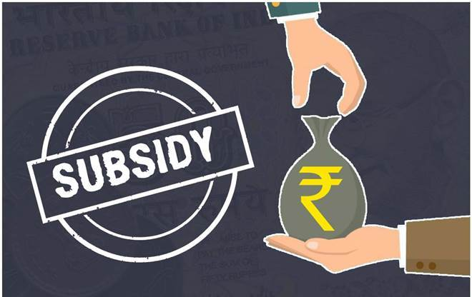

Slide 20
Subsidy is an amount of money given by the Government to an industry or business keep the price of a commodity or service low.

Slide 21
Arguments against subsidies
(i) Soon after independence, it was necessary to give subsidies to encourage the farmers to adopt the new technology. Now, the new technology is widely adopted and it is profitable. So, subsidies can be abolished.
(ii) Subsidies mostly benefit only the fertiliser industry and the rich farmers. The poor farmers and agricultural workers are not benefited.

Slide 22
(iii) The government has to spend a major part of its income to provide subsidies. So, the government does not have adequate resources for developmental activities.
(iv) Subsidies encourage the farmers to use more fertilisers than required. This destroys the natural fertility of the soil.

Slide 23
Arguments in favour of subsidies
(i) Farming in India is risky. Subsidies are needed to encourage the farmers to take the risk.
(ii) Most of the farmers are poor. They cannot afford to buy the agricultural inputs without subsidies.
(iii) Abolition of subsidies will widen the gap between the rich and the poor.

